Slide 1
MService MSCTD-884
Confidential to Selfservit Solutions

Slide 2
Checklist
1.Handover Document

Slide 3
Repository Name:
1.src-cc-delaval-in

Slide 4
IMPACT ANALYSIS
The files which is going to add and modify is
DATA SCRIPTS :
DB\DATA SCRIPTS\235\dbo.category_type_link.Table
DB\DATA SCRIPTS\235\dbo.code_table.Table
DB\DATA SCRIPTS\235\dbo.code_table_mlingual_translation.Table
DB\DATA SCRIPTS\235\dbo.item_master.Table
DB\DATA SCRIPTS\235\dbo.item_rate.Table
DB\DATA SCRIPTS\235\dbo.product_customization_udf_value_mapping.Table
DB\DATA SCRIPTS\235\update_script.Table
DB\DATA SCRIPTS\235\dbo.company_notification_rules.Table

Slide 5
IMPACT ANALYSIS
PROCEDURES :
DB/PROCEDURES/dbo.sp_retrieve_listof_values_for_searchcondition_delaval.StoredProcedure.sql
DB/PROCEDURES/dbo.sp_retrieve_quotation_detail_for_docgen.StoredProcedure.sql

Slide 6
IMPACT ANALYSIS
CONFIGURATION
RULE :
1. Website\webui\configuration\rule\rule_manage_call_requirement_entry_pe_delaval_in
2. Website\webui\configuration\rule\rule_manage_quotation_master_spares_edit_child_delaval_in
3. Website\webui\configuration\rule\rule_manage_item_master_edit_delaval_in
4. Website\webui\configuration\rule\rule_manage_quotation_master_spares_edit_delaval_in

Slide 7
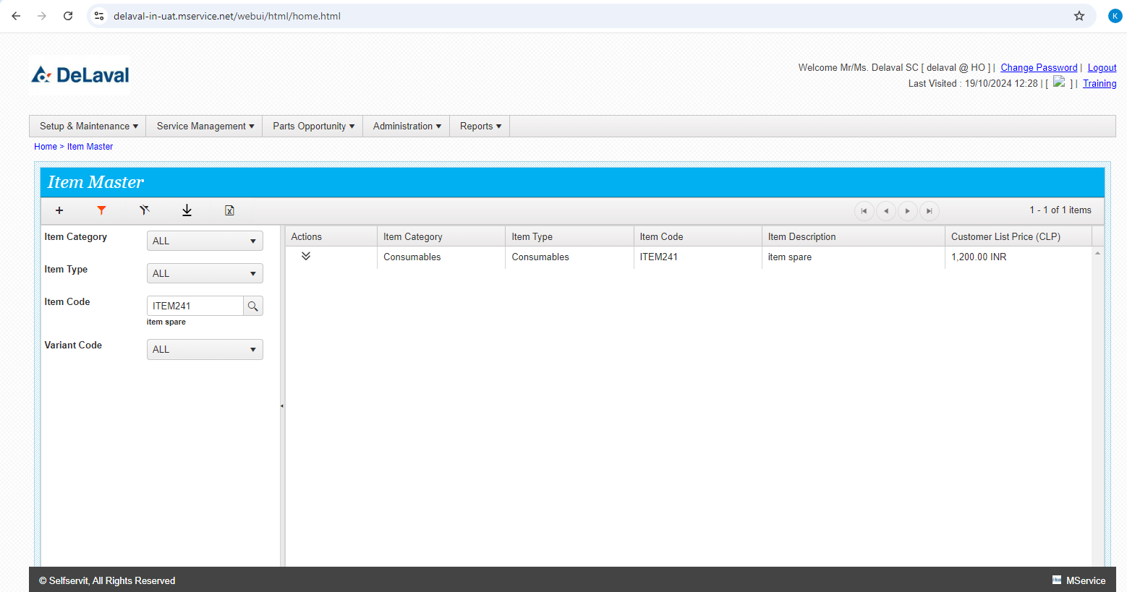
Item Master Filter Screen

Slide 8
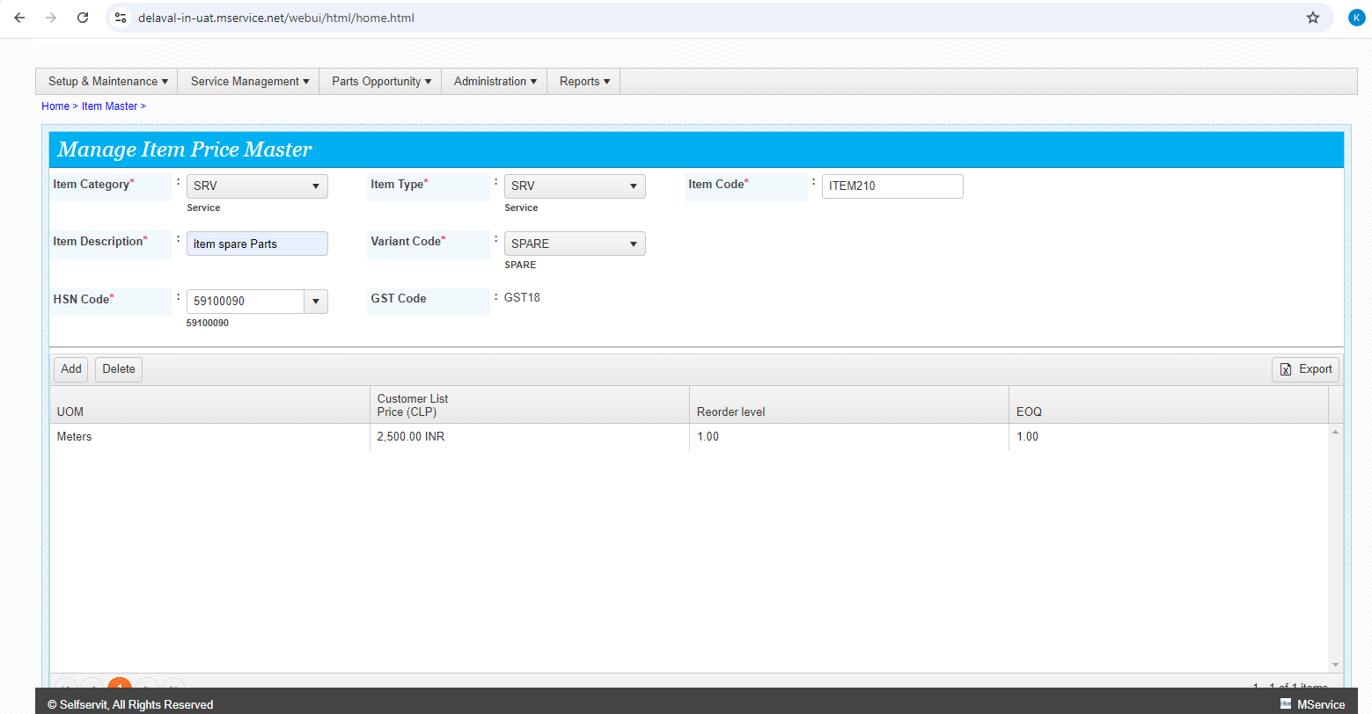
Item Master Add Screen

Slide 9
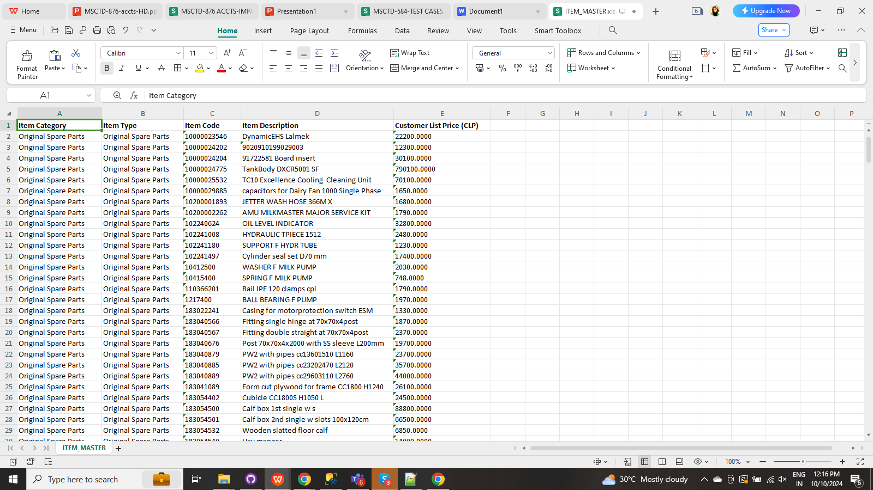
Item Master Export Excel

Slide 10
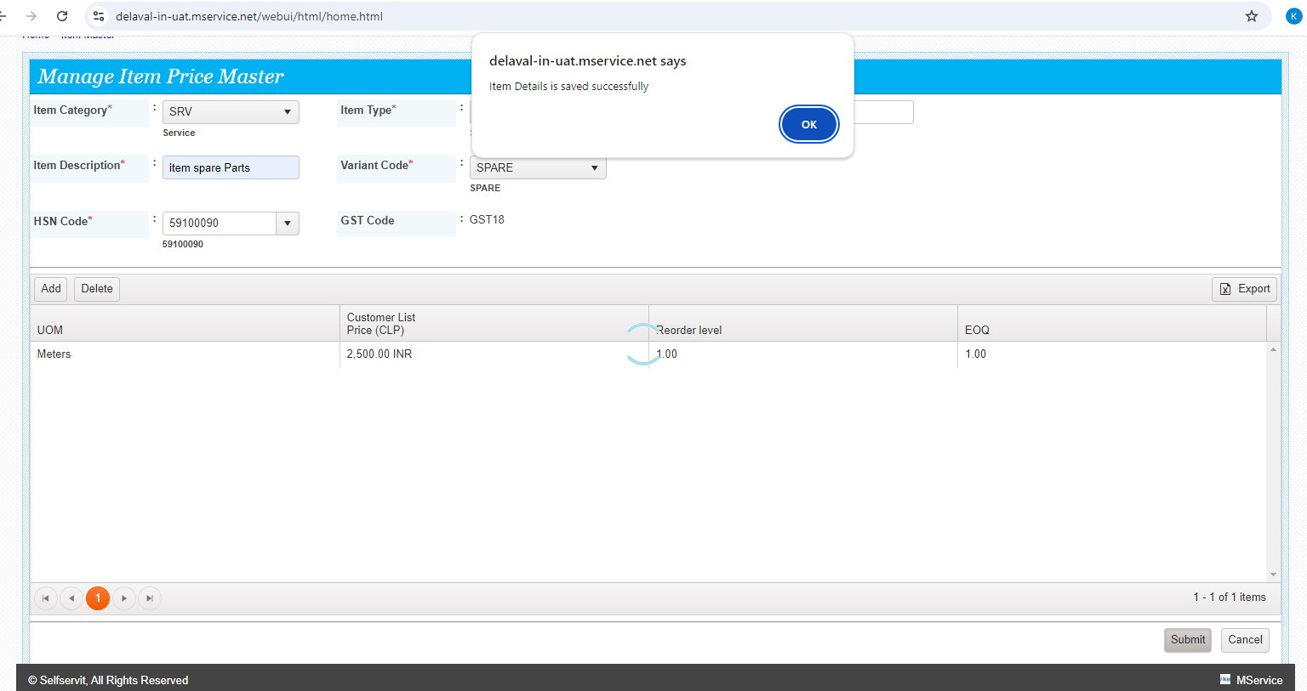
Item Creation Screen

Slide 11
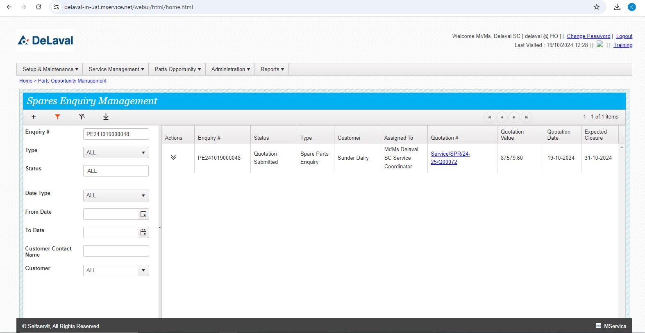
Spares Enquiry Filter Screen

Slide 12
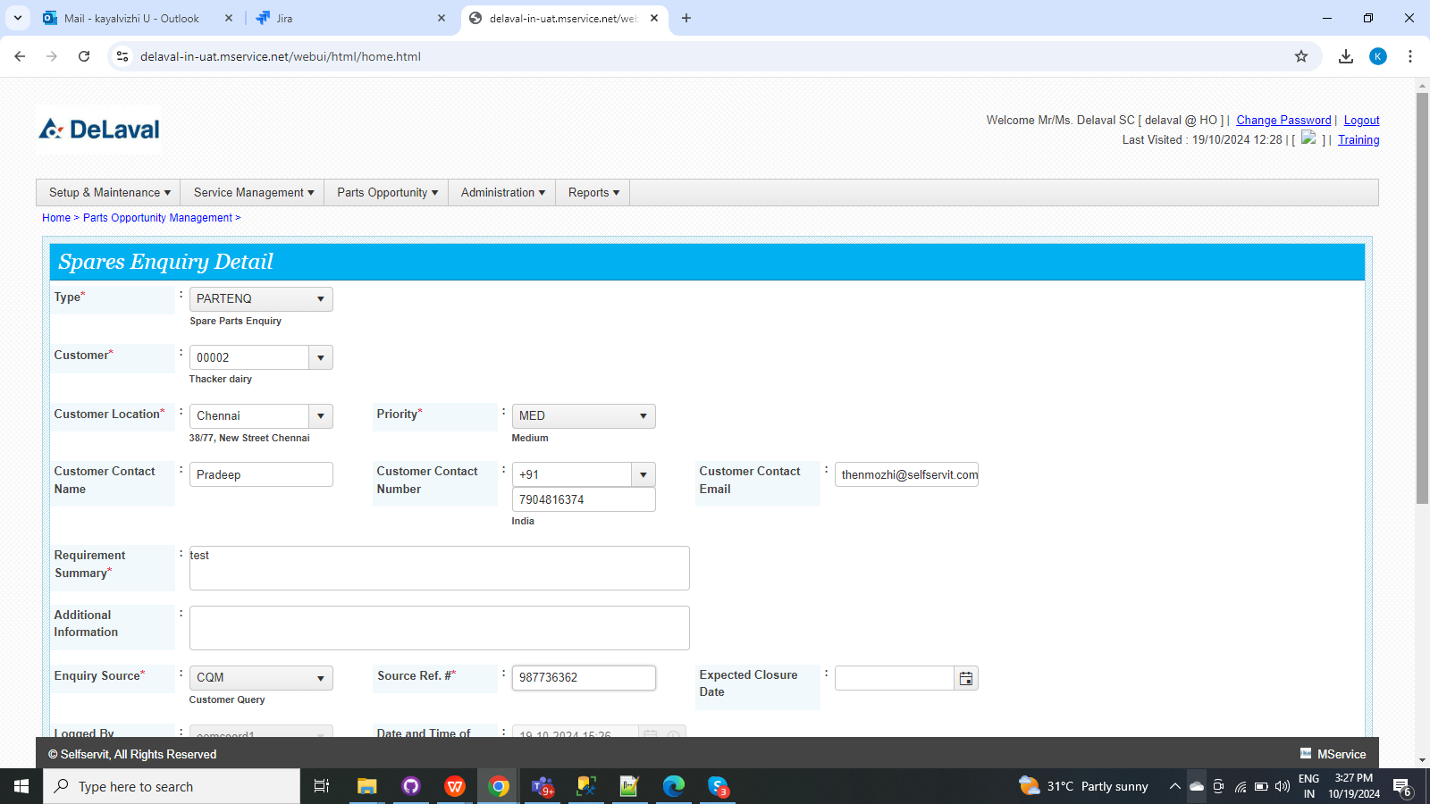
Spares Enquiry Add Screen

Slide 13
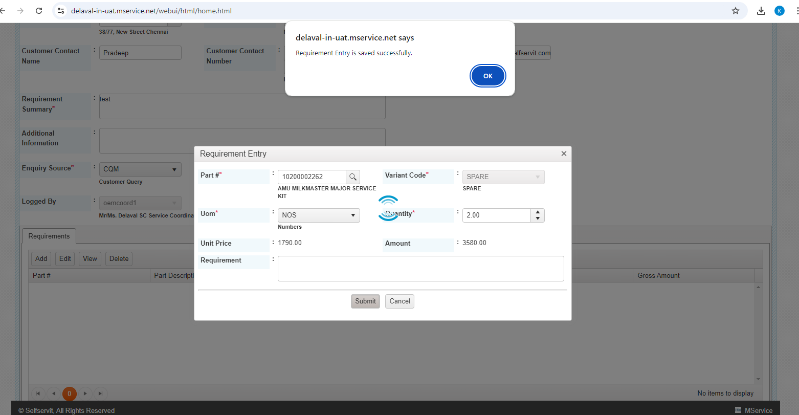
Spares Enquiry Child Screen

Slide 14
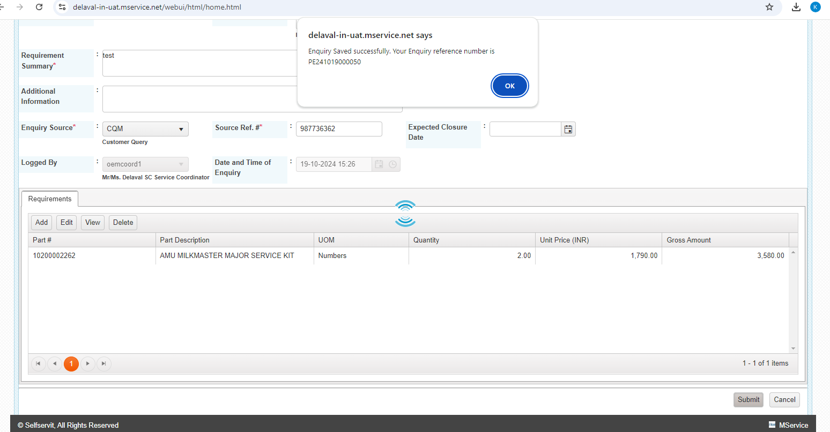
Spares Enquiry Creation

Slide 15
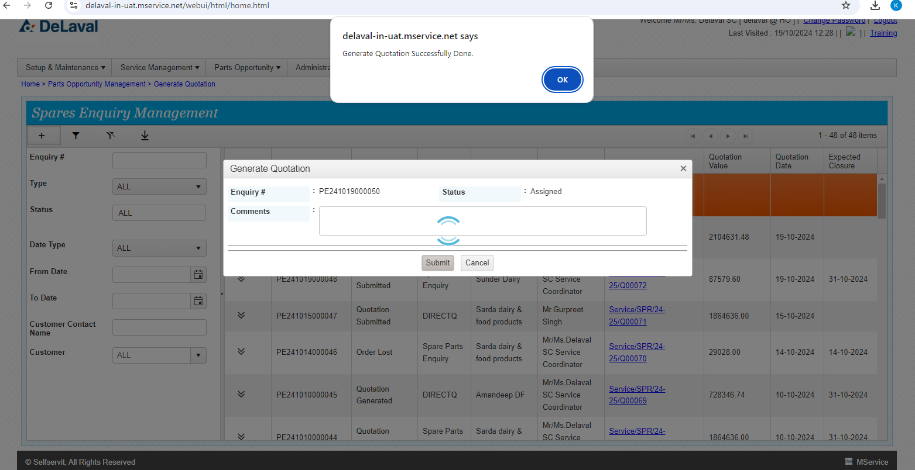
Spares Enquiry Quotation Generation

Slide 16
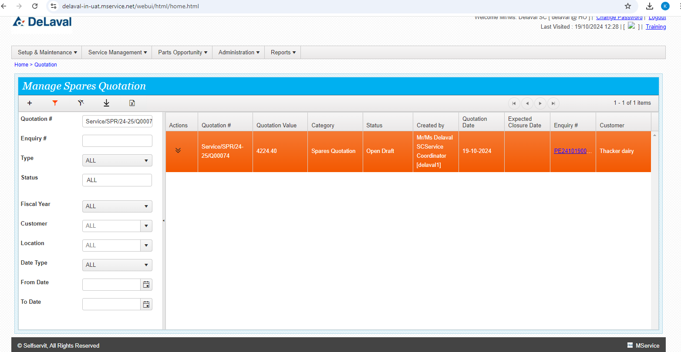
Quotation Filter Screen

Slide 17
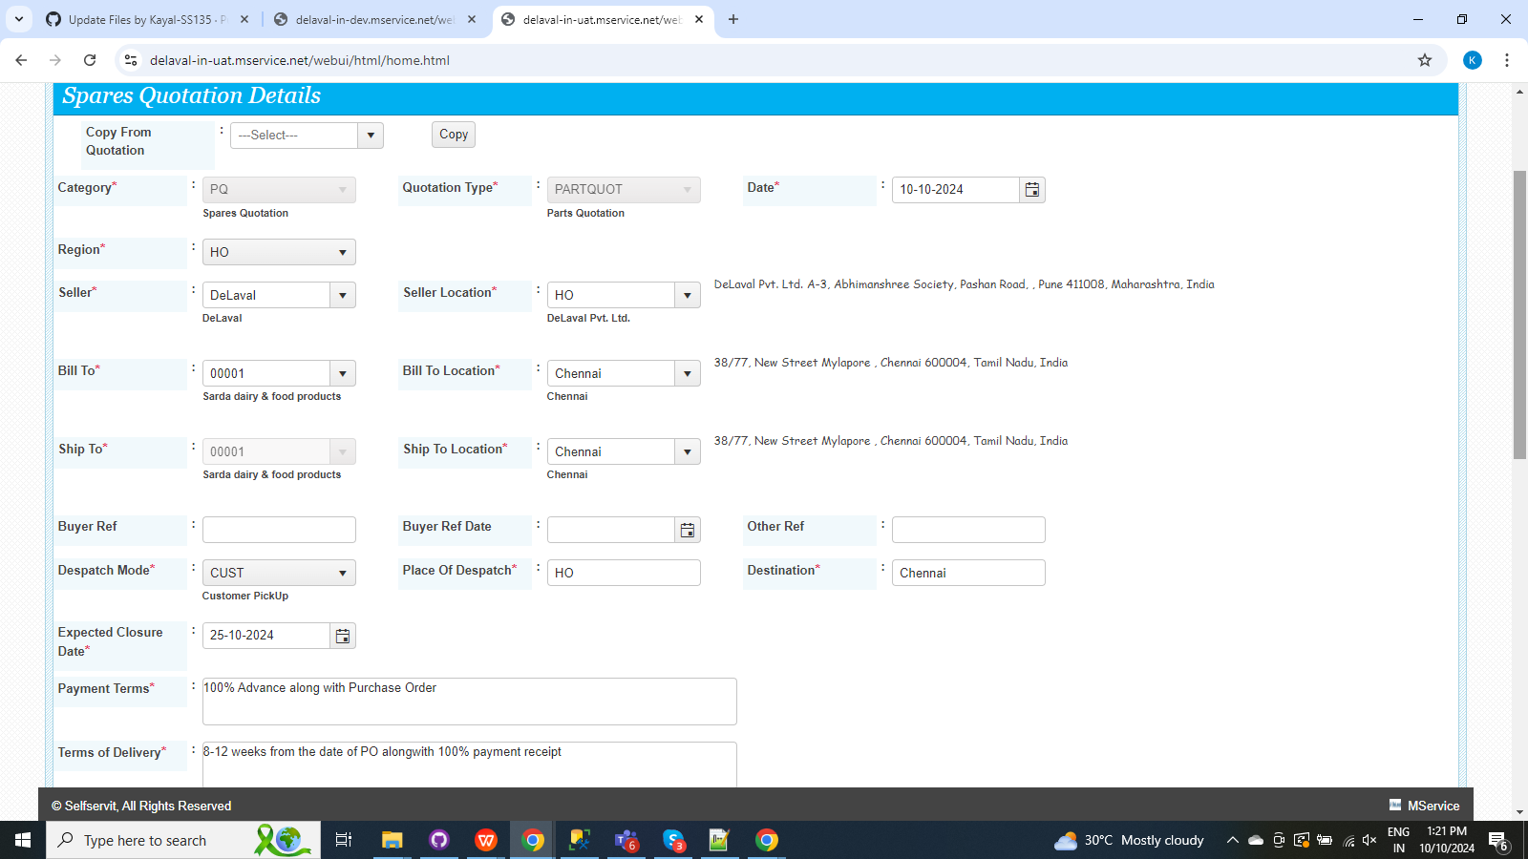
Quotation Add Screen

Slide 18
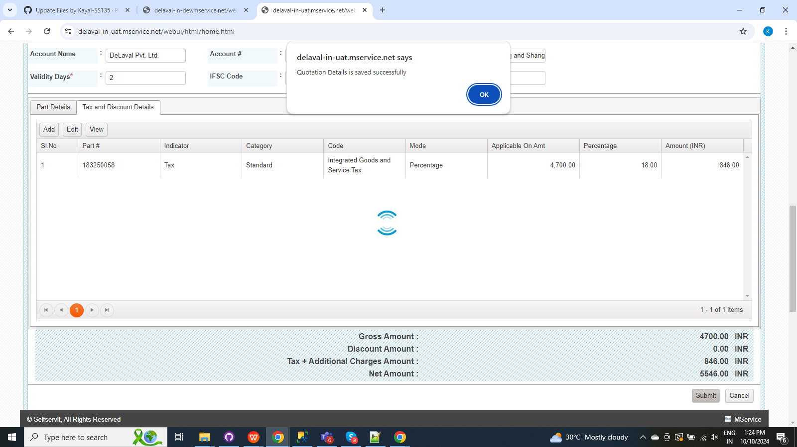
Quotation Creation

Slide 19
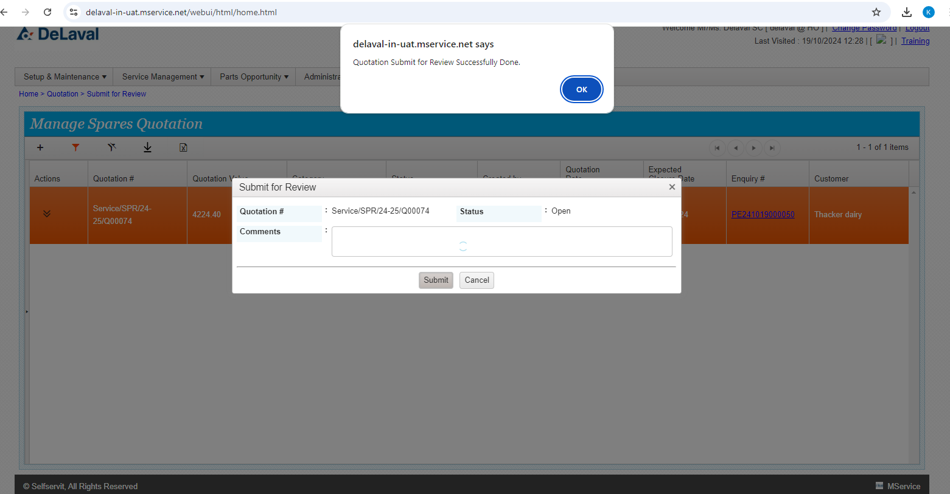
Quotation Submit for review

Slide 20
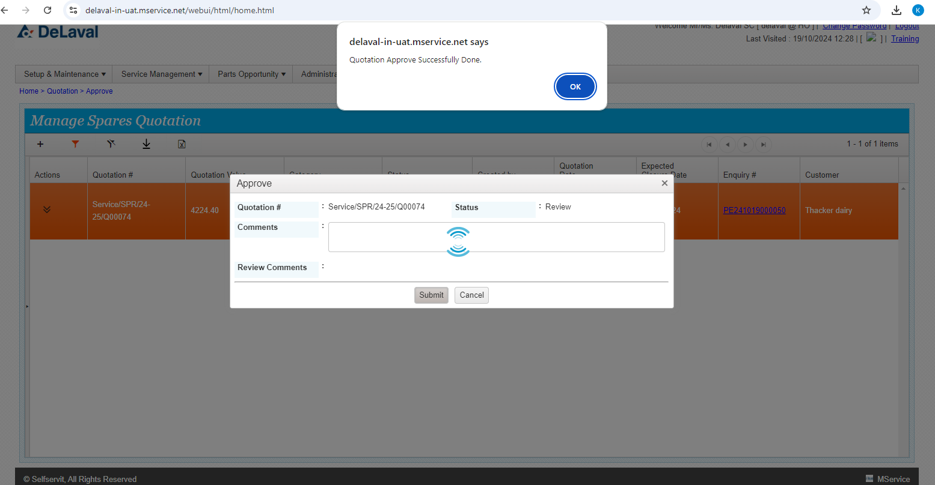
Quotation Approve

Slide 21
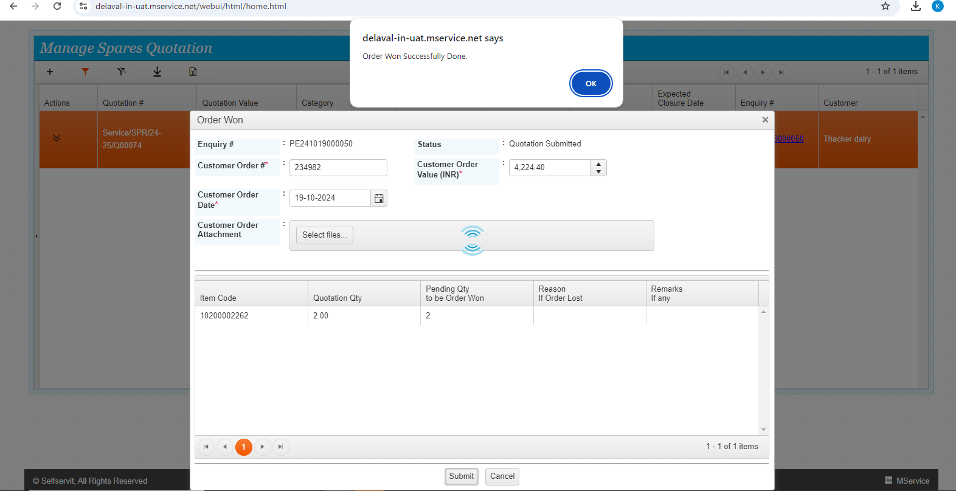
Quotation Order Won

Slide 22
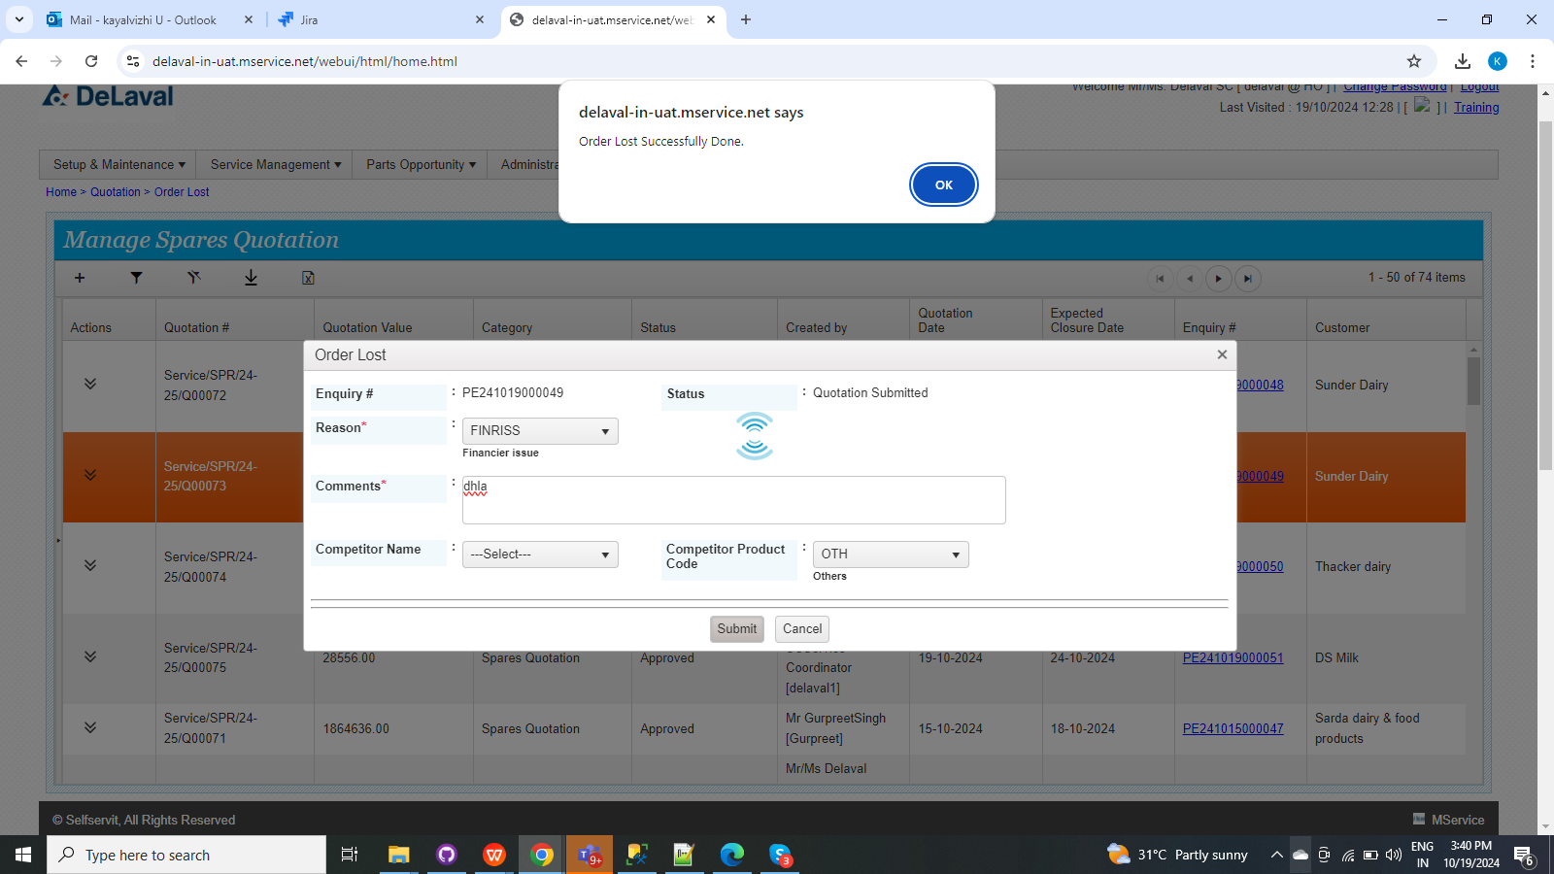
Quotation Order Lost

